Slide 1
TOPSI 2.0
The future of SOK stores’ and chains applicastions
Capgemini
xx^{th} August 2015

Slide 2
Why this approach?
Application lifecycle management
One cross functional team
Critical success factors
References

Slide 3
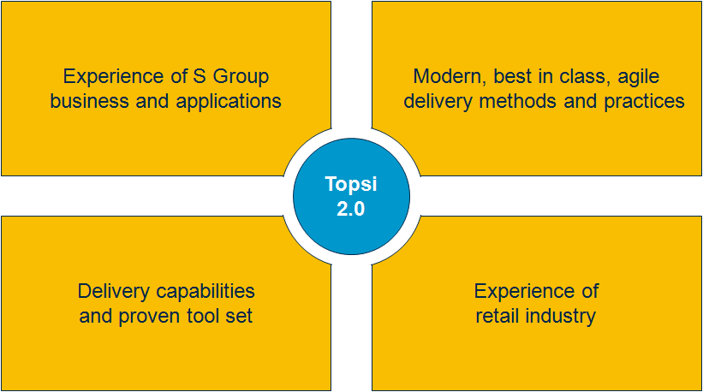
This document describes Capgemini’s vision of the future state of managing SOK’s business critical applications
We have created a concrete vision of the Topsi future state application management solution.
Our approach and solution is built on…
Our wide experience of S Group business and applications
Our deep understanding of modern, best in class, agile application development, application management and application operations delivery methods and practices
Our delivery capabilities and proven tool set
Our experiences of similar services in retail industry.

Slide 4
Efficiently managed application lifecycle requires one seamless and agile pipeline from business to operations
Our solution removes the borderlines between application development and application operations thus bringing true agility to the whole pipeline end-to-end.
Business
Development
Testing
Operations
Topsi 2.0 Application Lifecycle
Continuous Integration – Continuous Delivery
Agile Development – Automated Testing – Automated Deployment – Scalable Infrastructure
This approach brings unbeatable benefits but requires a major mindset change
and transformation from several silos to one pipeline.

Slide 5

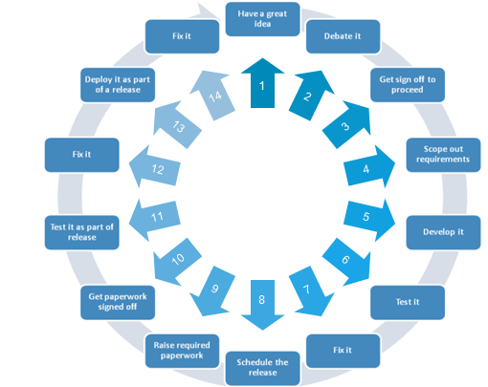
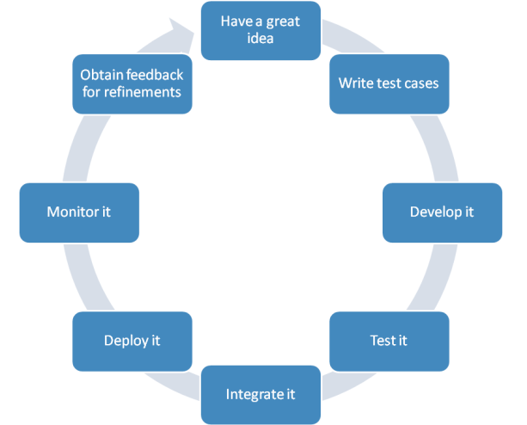
The objective is to simplify and streamline the application lifecycle management from development to operations
1
2
3
4
5
6
7
8

Slide 6
We have chosen this approach due to the multiple benefits it brings to SOK in terms of improved quality…
Area
Benefits
Improved Quality
Easy and faster access to new features and business functionalities: capability to meet the constantly changing business requirements
Higher end-to-end availability and successful days at business processes due to:
Less disruptive upgrades
Less hand-overs within release deployments
Automated provisioning
Automated testing
Automated deployments
Better change management in the whole environment
Improved security.
Flexibility and Agility
Lower Lifecycle Costs

Slide 7
… in terms of increased flexibility and agility throughout the pipeline…
Area
Benefits
Improved Quality
Faster time-to-market of solutions that meet changing business needs due to:
Built-in flexibility when moving from Waterfall IT to Agile IT
Acceptance of changes in smaller, granular and manageable portions
Shorter development-to-production lifecycle
Increased automation level in
Continuous integration
Testing
Continuous deployment
Infrastructure provisioning
Improved capability to cope with changes in application landscape and support introduction of new technologies:
Our agile one pipeline model supports Topsi landscape SATO transitions
Our model is the most efficient operating model also in post-SATO world.
Flexibility and Agility
Lower Lifecycle Costs
The best model for managing current applications’ lifecycles, SATO transitions and post-SATO application landscape!

Slide 8
…and remarkable overall cost savings
Area
Benefits
Improved Quality
Significantly lower development costs due to
Simplified and agile sw-development process (e.g. case Fosteri)
Efficient use of offshoring also in development
Less manual work in all phases due to increased automation
Lower infrastructure costs due to dynamic, scalable capacity and resource scaling
Lower license costs due to use of SaaS and Open-Source Software tools
Less effort spent on wasteful deliveries due to stable and predictable releases.
Flexibility and Agility
Lower Lifecycle Costs

Slide 9
Why this approach?
Application lifecycle management
One cross functional team
Critical success factors
References

Slide 10


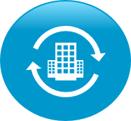
Today ”DevOps” is a widely used buzzword, but we know how to exploit the DevOps principles in real life
What the industry says
What we say and do with our clients
Wikipedia
A software development method that stresses communication, collaboration and integration between software developers and information technology professionals
http://en.wikipedia.org/wiki/DevOps
DevOps is a way of collaborating and industrializing using highly automated approaches to deploy solutions that evolve as fast as your business needs it
Techopedia
A “project management” philosophy: “The term DevOps is commonly considered a combination of the concepts of Development and Operations. It is used in IT to refer to roles or processes that bridge various departments – usually Development and Operations teams – to achieve a certain project management philosophy that involves more efficiency in communications between Development teams and other parts of a greater business or organization.”
EMA
Analysts
The ideal intersection of people, processes, and tools across the application lifecycle, facilitating the seamless delivery of software to the business
By adopting DevOps an organization can dramatically improve the value delivered by its business.
Gartner
A philosophy to improve collaboration between operations and development teams; better utilize technology, especially automation tools
http://www.gartner.com/it-glossary/devops
IBM
Transforming software delivery for enterprise innovation with real business outcomes
http://www.ibm.com/ibm/devops/us/en/
The team centric DevOps ethos tears down traditional silos to tightly integrate business, development and operations to drive agility and service delivery excellence across the entire lifecycle.
TCS
It is an Agile-based approach to integrating operations personnel with development personnel during the software development cycle to ensure that the software is operable and supportable in the production environment as and when the software needs to be released
http://www.tcs.com/resources/white_papers/Pages/DevOps-software-development.aspx

Slide 11
One of the most important objectives of our chosen approach is to remove waste in application management
Today waste is generated in many areas…
Manual Work Deployments require human intervention and actions We must rely on release and environment specific installation instructions and scripts Environment configuration is done on an “as-needed” basis
Long Wait Times Throughout The Pipeline Teams waiting on manual handoffs Delayed time-to-test Insufficient notification
Unproductive Work and Inefficient Use of Environments Deploying things that have not changed Deploying same things several times in many environments Using static environments, not leveraging virtualization & cloud Managing infrastructure & apps separately
Poor Visibility Outside the Silos Reliance on release notes, spreadsheets, distribution lists, etc, and high number of status meetings and calls Limited understanding of deployment dependencies and status Long or too many outage windows
…but it can be removed radically by:
Removing Activities Requiring Manual Work Automated deployments Graphical process designer Environment configuration managed as part of deployment (scalable infrastructure)
Eliminating Long Wait Time Bottlenecks Automated notifications Include provisioning as part of deployment Add automated testing to deployment process
Reducing Root Causes of Unproductive Work Only deploy what has changed Leverage production-like environments e.g. in testing Get the most out of virtualization & cloud Manage infrastructure & applications together
Raising Visibility by Removing the Silos and Setting Up One Team Known status of resources at-a-glance Immediate view of deployment compliance Status, feedback & understanding of all parts of deployment as it occurs

Slide 12
Agile principles support application life cycle management
Minimum viable product -thinking

Slide 13
Efficiently managed application lifecycle in SOK’s complex environment
One team
No silos between
Dev, Ops, Infra
and Testing
Agility
Build-Release- Run-Repeat
Automation
Integrated toolsets and service virtualization
Means: Combined AD/AM/IS team that takes care of all SOK Kemy systems
Means: Agile development and continuous deployment packed with dynamic capacity
Means: Automation everywhere supported by PaaS, IaaS and Best of Breed solution

Slide 14


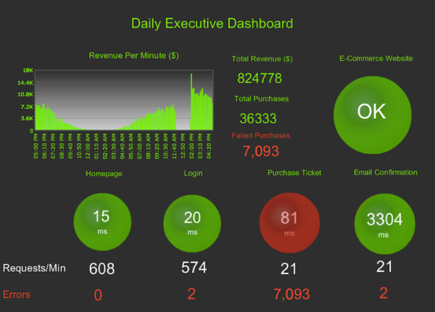
The application lifecycle from business to operations
Minna
Cost Saving
Minimum viable product
Right time
Rapid time to value
Business Development Testing Operations
From silos to one pipeline

Slide 15


Capgemini Continous Delivery Technology solution
Capgemini continous delivery technology solution
Automated testing and security
Real-time application performance monitoring throughout application lifecycle
Node
Node
Node
Development process based on feedback and customer needs
Node
Node
Node
Feedback /
Metrics,
Real Data on End User Experience
Node
Node
Node
Node
Node
Node
Puppet /Ansible
Puppet /Ansible
Puppet /Ansible
DEV/
SYST
UAT
PRE-PROD
PROD
Remote server automation and virtualization (Dynamic capacity)
Feature
Branch
Continuous Delivery
Agile Development
Continuous Integration
Open Pull
Request
Unstable / Develop
Branch for release
Release – 1.0
Release sign-off
Promote release
Release – 1.0
GIT / Stash
Merge
Pull Request
Delivery Orchestration (ServiceNow)
Agile way of working

Slide 16
Agile Development
Purpose
Agile software development is a group of software development methods in which requirements and solutions evolve through collaboration between self-organizing, cross-functional teams. It promotes adaptive planning, evolutionary development, early delivery, continuous improvement, and encourages rapid and flexible response to change.
Key activites
How coding is managed
Daily stand up and Scrum meetings
Managing back log
Change management (SCM)
ALM
Ari Paajanen: Mitä työkaluja käytettiin Fosterissa?? Sanna Virtanen / Tommi Lehto -> Meidän agileprojektityökalut
Capgemini tools:

Slide 17
Continuous Integration
Seetesh
Improve code quality by minimizing the time between merging code snippets done by individual developers
Monitor code quality by testing (compiling) it daily
Enforce code quality by not allowing commits for code that does not compile
Purpose –Why?
Commit code to central repository several times a day
Check-in is verified by an automated build
Run Code Review tools to perform static code analysis
Jenkins (job having Build files) to create the binaries (war, ear) for deployments on to the Application Servers including packaging the different modules/applications
Key activites –What?
Maven or Ant - Build
Jenkins or Bamboo – Build Server
Scripts in Jenkins - Deploy
GIT or SVN - Configuration Management/Repository
CAST, SonarQube, CheckStyle – Code Review
uDeploy, Nolio Zero Touch Deployment - Automated release mgmt
Package
Capgemini tools:

Slide 18
Continuous Delivery
Seetesh
Purpose –Why?
Manage, plan and control the storage of binaries used for
deployments relying on the software release cycles.
It also controls the flow of binary artifacts from development to
production environment.
Automate and improve the process of software delivery.
Key activites –What?
Techniques such as continuous integration, continuous deployment and automated testing allow software to be developed to a high standard and easily packaged and deployed to test environments, resulting in the ability to rapidly, reliably and repeatedly push out enhancements and bug fixes to customers at low risk and with minimal manual overhead.
Capgemini tools:
Nexus
Redis
Artifactory or Jenkins Plugins

Slide 19
Test Automation
Enable early detection of functional errors and give immediate feedback to developers thus increasing code quality
Improve time to market with virtual test environments (by reducing the requirements for non-scope environments to be available for test runs)
Purpose -WHY
Test automation is the use of special software (separate from the software being tested) to control the execution of tests and the comparison of actual outcomes with predicted outcomes.
Faster time-to-market with quality software functionality at lower infrastructure cost.
Key activites -WHAT
Automatic testing
Selenium or QTP or HP Tester
Capgemini tools:

Slide 20
Security (+Service Virtualization?)
Emma
Purpose
Key activites
Service Virtualization captures and simulates the behavior, data and performance characteristics of complete composite application environments, making them available for development and test teams throughout the software lifecycle,
Sogeti SaaS
Service virtualization
Capgemini tools:

Slide 21
Application Performance Monitoring (APM)
Emma
Enable feedback loop for the team,
Monitor IT infrastructure
Detect security breaches, Plan & budget for IT upgrades
Reduce downtime and business losses
Prevent problems by automatically collection the normal metrics for normal application performance and comparing those to the current state in real time
Purpose
APM tools alert IT staff to disruptions in availability and/or quality. In addition to real-time monitoring, many application performance management tools prevent problems from occurring by detecting early warning signs of issues and can also help automatically resolve some performance and quality issues
Key activites
Analysis, Alerts
AppDynamics
New Relic
Nagios
Graphite, Gomez
Capgemini tools:

Slide 22
Capgemini Dynamic Infrastructure
Saki
Purpose
Reduce pricing trough pay-as-you-go model
Reduce time-to-market
Increase quality, reliability and visibility of infrastructure
Key activites
Dynamic Capacity with horizontal & vertical scalability
Automated provisioning via self service portal
Fast, versatile and standard delivery
High-secure infrastructure
Capgemini tools:
Capgemini Nordic Cloud

Slide 23
Delivery Orchestration (to me removed)
Purpose
xxxx
Emma: do we want to highlight
Security,
Microservice architecture (API), ALM (ticketing system) ?
Key activites
How coding is managed
Daily stand up meetings
Managing back log
Change management (SCM)
ALM
Xxxxx
Ari Paajanen: Mitä työkaluja käytettiin Fosterissa?? Sanna Virtanen / Tommi Lehto -> Meidän agileprojektityökalut
ServiceNow
Capgemini tools:

Slide 24
Why this approach?
Application lifecycle management
One cross functional team
Critical success factors
References

Slide 25
One cross-functional team is responsible for the application product end-to-end
Emma
Traditional silos are destroyed and everybody has access to same dashboards and tools
Instead of each team focusing separately either on coding, testing or deploying everybody focuses on the product itself and strives for common goal
New approach improves efficiency and knowledge sharing
It tightly integrates business, development and operations to drive agility and delivery excellence across the entire lifecycle
Notes:
siloed teams, each with differing motivations and areas of focus doesn’t deliver consistency.
Common goals, tools and processes
Team is empowered to self-sufficient as they can code, test and deploy

Slide 26
Certain roles are vital for successful implementation of agile methods throughout application lifecycle
Emma
Automation Architect analyze, design, and implement automation strategies
Release Manager oversees coordination and integration of development, testing and deployment tasks to support continuous delivery
Experience Assurance Professional ensures that all new features and functions are released with intended end user experience
Technical specialists takes care of both development and operational tasks and testing
Product Owner is responsible for the product success and value creation
SCRUM Master is responsible for the success of agile processes
Microservice and Service Virtualization Architect defines and designs microservices and service virtualization
Utility Professional operates across development platforms, tools, networks, servers and databases to ensure quality and resource management are taken care of
Security Engineer works side by side with developers to ensure security issues are taken into account early in the process

Slide 27
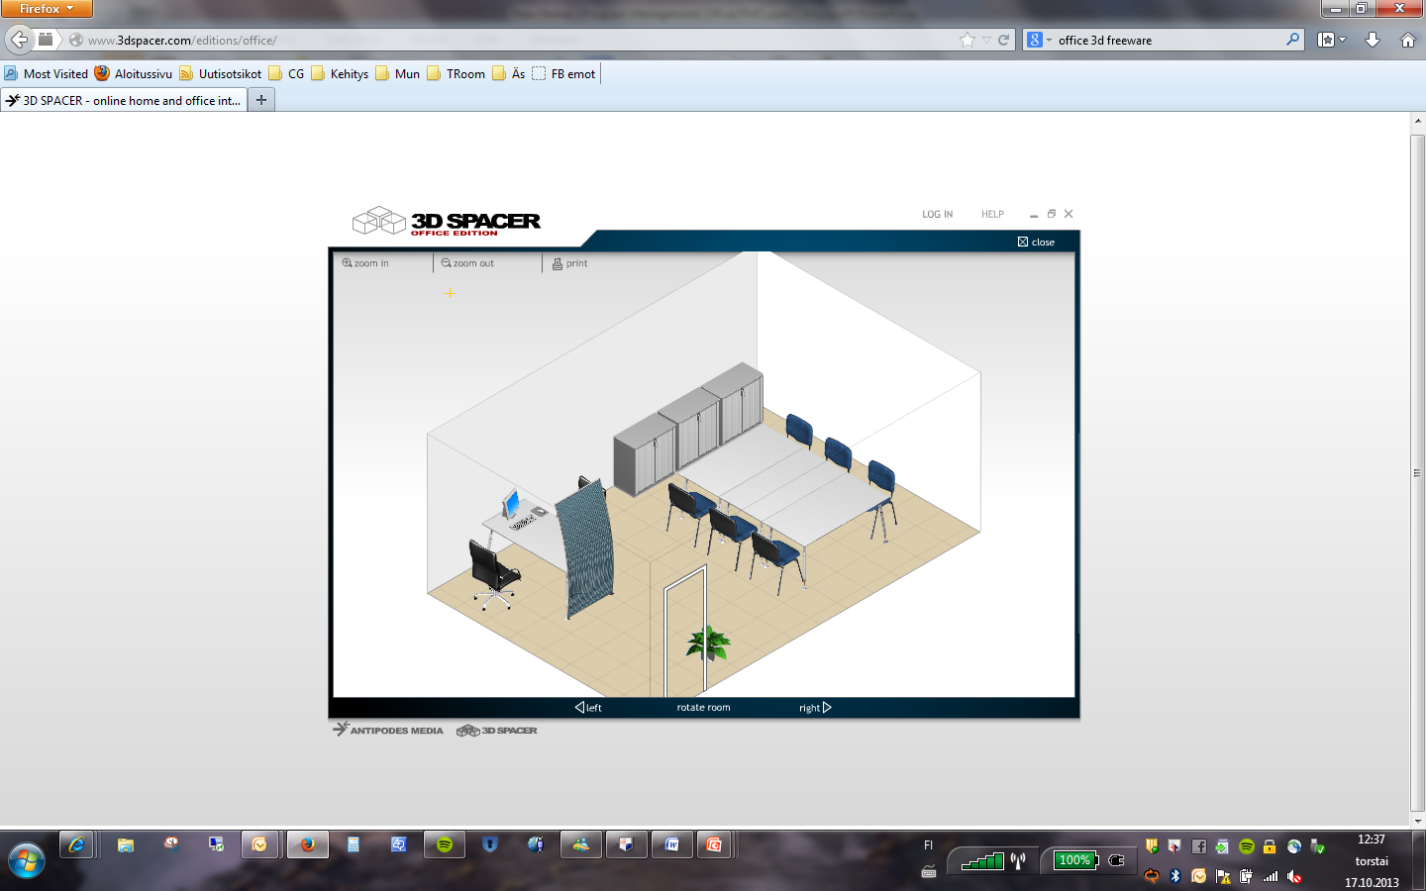
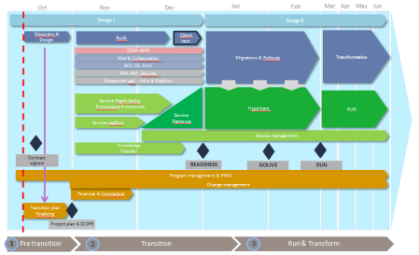


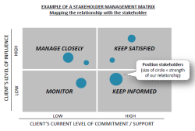
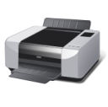
One team works efficiently cross border using war room
Emma
HIGH
Impact
LOW
LOW
Likelihood
HIGH

Slide 28
Why this approach?
Application lifecycle management
One cross functional team
Critical success factors
References

Slide 29
Critical success factors in Dev Ops transformation / “Must Fix”
SaaS tools
Dynamic capacity
Automated testing
APM???
Automated security testing
Static code analysis

Slide 30
Why this approach?
Application lifecycle management
One cross functional team
Critical success factors
References

Slide 31
Benefits of DevOps have been verified by several research companies
Heli
High-performing IT organizations deploy 30x more frequently with 200x shorter lead times;
they have 60x fewer failures and recover 168x faster.
Lean management and continuous delivery practices create the conditions for delivering value faster, sustainably.
High performance is achievable whether your apps are greenfield, brownfield or legacy.
IT managers play a critical role in any DevOps transformation.
Diversity matters.
Deployment pain can tell you a lot about your IT performance.
Burnout can be prevented, and DevOps can help.
Source: Puppet Labs; 2015 State of DevOps Report

Slide 32
This is not only theoretical approach, this is real life
In Capgemini we have reached the following improvement with this approach:
50% faster solution deployment time
96% faster creation of new environment
20% reduction in FTEs
Significant improvement on availability (from <99,4% to >99,6%)
Example from one of our clients
Heli

Slide 33
Start DevOps Organizational Adoption Before It Becomes a Burning Issue
Heli
70% of IT organizations that do not adjust their organizational structures as part of their DevOps adoption plans will fail to achieve the desired results from their DevOps implementation.
Static hierarchical structures typically do not offer the flexibility or responsiveness required.
A virtual team, as opposed to solid-line reporting.
One key factor is ownership of the overall team result.
The customer is part of the team.
Having the voice of the customer within the team can reinforce the overall goal and further aid in bridging the gap between applications and operations.
Source: Gartner; Organize the Right Teams for Successful DevOps, 27.9.2012

Slide 34
Organizations who are employing DevOps practices are out-performing even the fastest high performers
In 2007 Visible Ops survey the high-performing IT organizations were:
5-7x times more productive
making 14x more changes, with
one-half the change failure rate
4x higher first fix rates,
10x shorter Severity 1 outages times.
4x fewer repeat audit findings
5x more likely to detect breaches by an automated internal control,
8x better project due date performance!
Organizations who are employing DevOps practices are out-performing our fastest high performer by orders of magnitude
Amazon has gone on record stating that they’re doing over 1,000 deploys a day, sustaining a change success rate of 99.999%!
Heli
Source: IT Process Institute, IT revolution press; Top 11 Things You Need To Know About DevOps

Slide 35
Worldwide cost of IT failure (revisited): $3 trillion
For just the Standard & Poor 500 companies, aggregate 2012 revenue is estimated to be $10 trillion.
If 5 percent of aggregate revenue is spent on IT, and conservatively, 20 percent of that spending creates no value for the end customer - that is $100 billion of waste!
Heli
Vähän liika höttöä on lähde
Source: http://www.zdnet.com/article/worldwide-cost-of-it-failure-revisited-3-trillion/

Slide 36
With DevOps approach the quality is not sacrificed to deliver fast
Development teams that consistently deliver at the fastest cycle times enjoy the highest business satisfaction.
Incremental improvements to waterfall methods run out of steam at one- to two-month delivery cycles.
Eight DevOps/continuous delivery practices are the key.
Deliver small increments of functionality;
Use dedicated, cross-functional teams;
Use loose architectural coupling;
Automate environment provisioning;
Continuously integrate code;
Continuously test;
Continuously fund; and
Provide real-time transparency.
DevOps practices address the top reasons for project disappointment.
DevOps practices reduce cycle time and the risk of failure at the same time.
Heli
Source: Forrester Consulting, The New Software Imperative: Fast Delivery With Quality, October 2014.

Slide 37
Benefits of DevOps are real and measurable
Heli
20 percent improvement in time-to-market,
22 percent improvement in software quality,
17 percent improvement in frequency of application deployments
22 percent more customers
19 percent increase in revenue
Source: TechInsights Report: What Smart Businesses Know About DevOps, September 2013

Slide 38
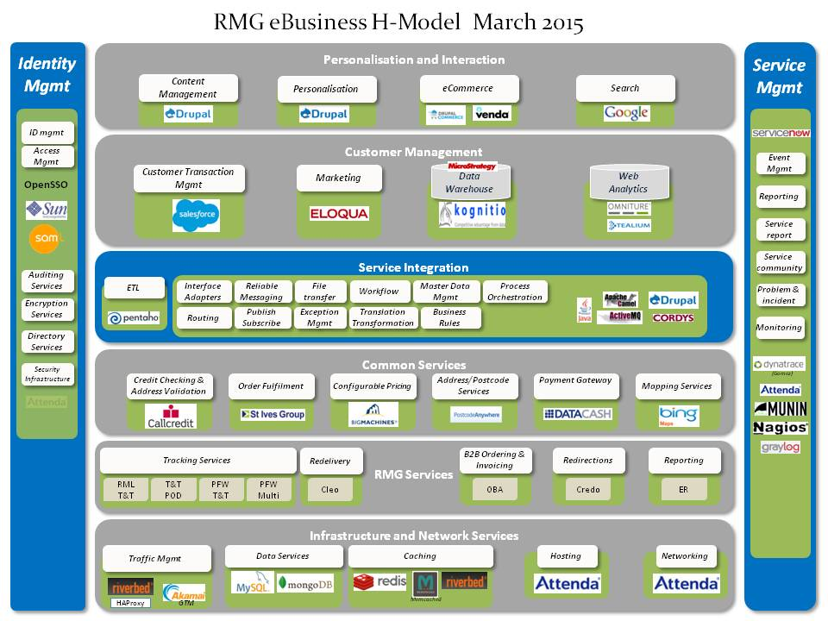
Case Royal Mail Group
Seetesh

Slide 39
Royal Mail Group - Benefits to the organisation
Ability to move with the landscape: With the new eBusiness service hasn’t been locked into to costly licences, which are difficult to break, and bring with them significant costs
Instead RMG has the flexibility to upgrade technology once a solution becomes outdated or something new hits the market
Ability to respond to the customer: The eBusiness service helps RMG to deliver a leading customer management service, with a single view of customers across sales, marketing and customer services
Streaming innovation: RMG can test, pilot and experiment with ready-made solutions without prohibitive up-front licence costs. In addition, with new web developments released every month gradual and continuous improvement across the business is encouraged
Economies of scale: Using Software as a Service with many other ‘tenants’ has the benefit of economies of scale relating to R&D and maintenance

Slide 40
Capgemini has wide experience in agile application lifecycle management
Seetesh
Include Philips reference list
Picture of logos

